Slide 1
“This end-to-end project utilizes Microsoft Fabric to convert raw financial data into strategic insights. Leveraging Dataflows Gen2, Lakehouse, and Power BI, the dashboard tracks monthly Income, Expenses, Net Profit Margin %, Budget Variance (Income/Expenses), Account Receivable/Payable, Cash EoM, and Net Profit — delivering real-time financial health analysis in a scalable, enterprise-grade environment”

Slide 2
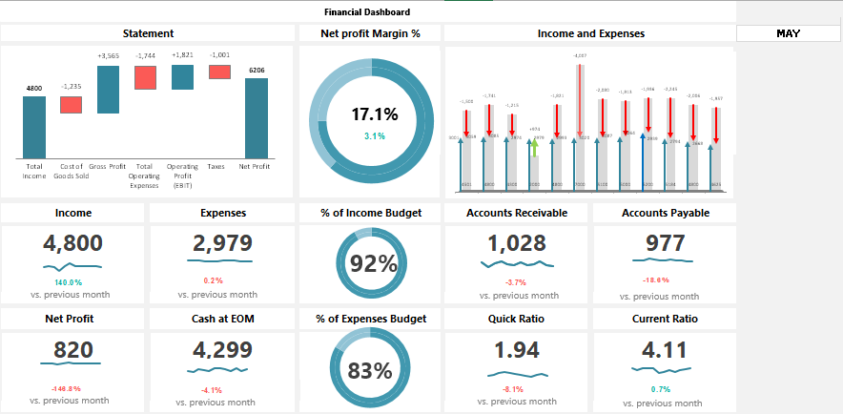
Cashflow Pro: Executive Financial Overview

Slide 3
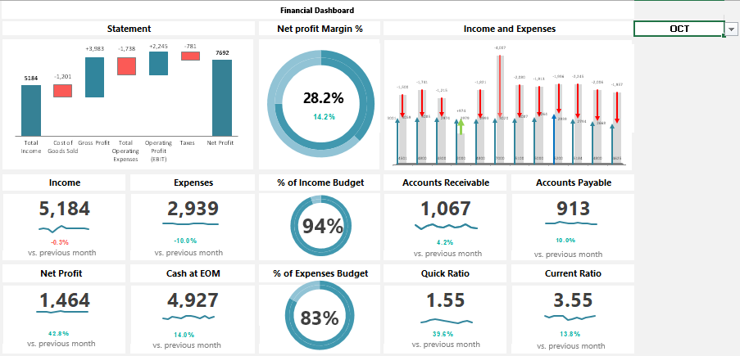
Cashflow Pro: Executive Financial Overview

Slide 4
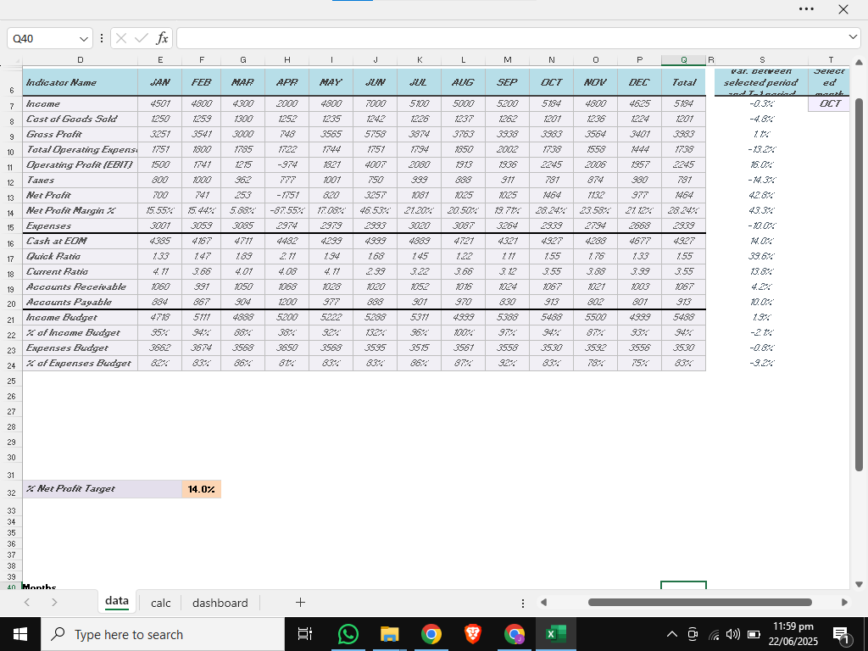
Cashflow Pro: Executive Financial Overview
Walmart - Stores clean and raw data

Slide 5
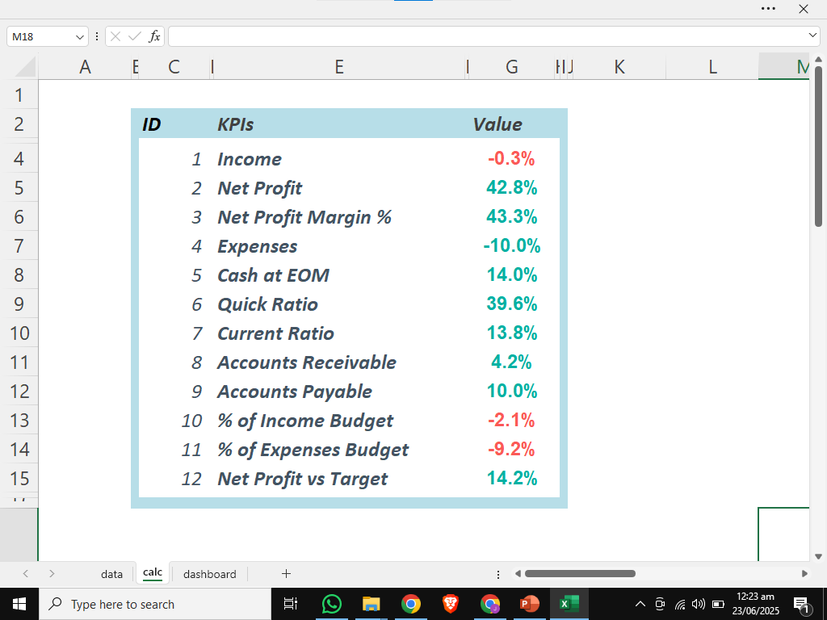
Cashflow Pro: Executive Financial Overview
Calculation Notebook

